Slide 1


智冠科技 數位發展中心
Google Cloud Platform Tutorial
智冠科技

Slide 2
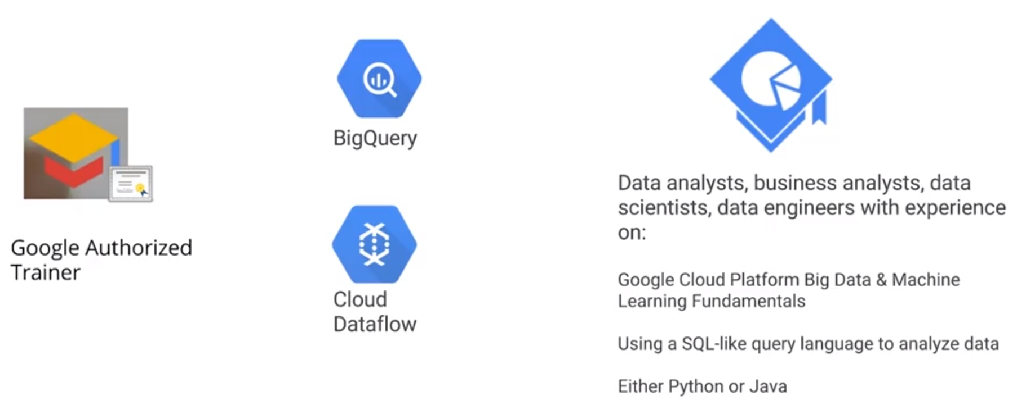
BigQuery and DataFlow
Server less / Autoscale way for Data Analysis
Data warehouse which interact primarily through SQL, Petabyte scale declarative way
Data processing pipeline system ,either for batch data or streaming data, which can be coded by Python or Java reliable/ scalable data processing system programmatic way

Slide 3
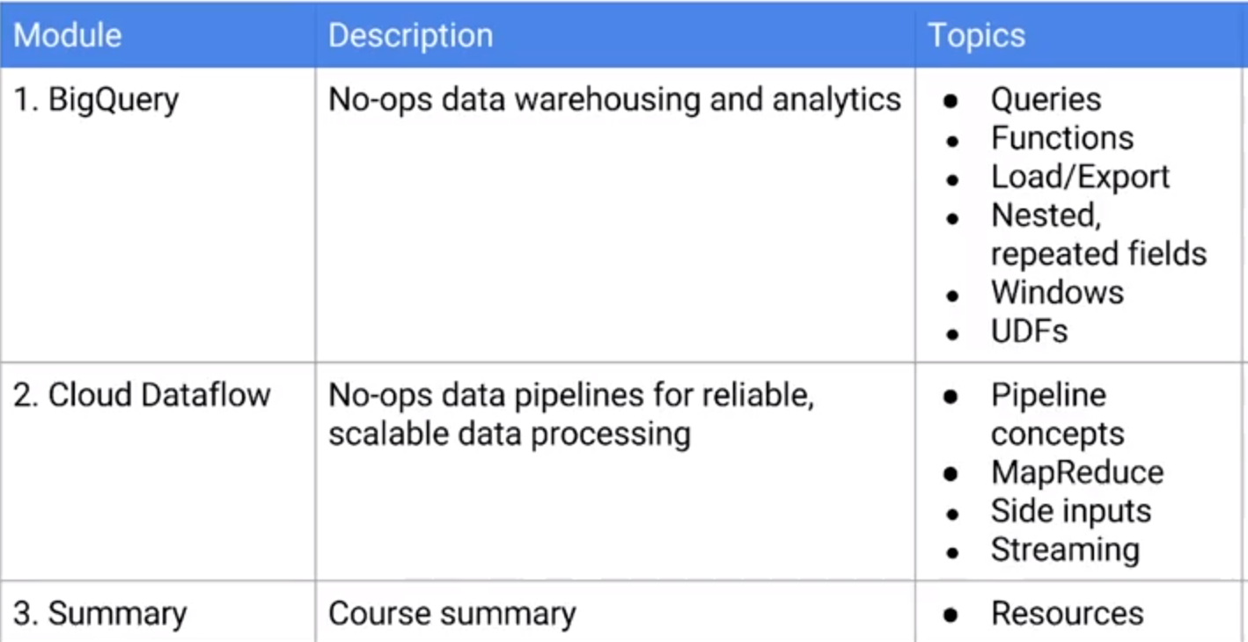
BigQuery and DataFlow
Server less / Autoscale way for Data Analysis
Small data to join with

Slide 4
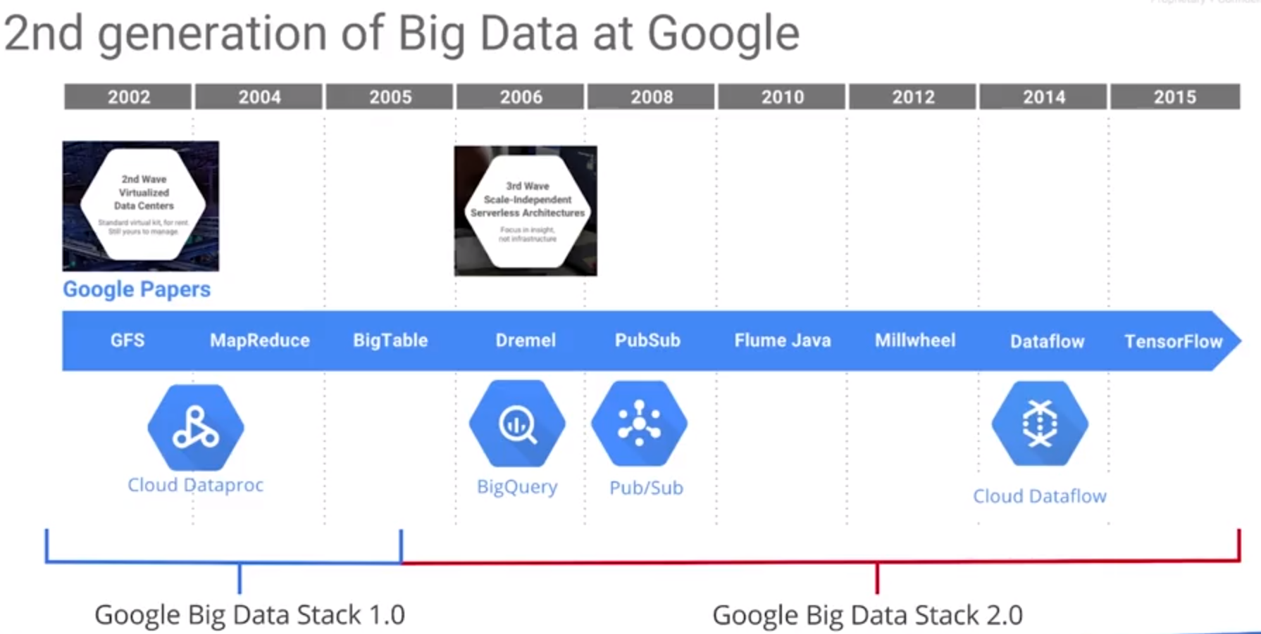
BigQuery, query large data set in seconds
1st GFS, Hadoop, MapReduce Shard data into small pieces to HDFS parallelize operations combine all the result from different notes
Server less / Autoscale way for Data Analysis
Internal External

Slide 5
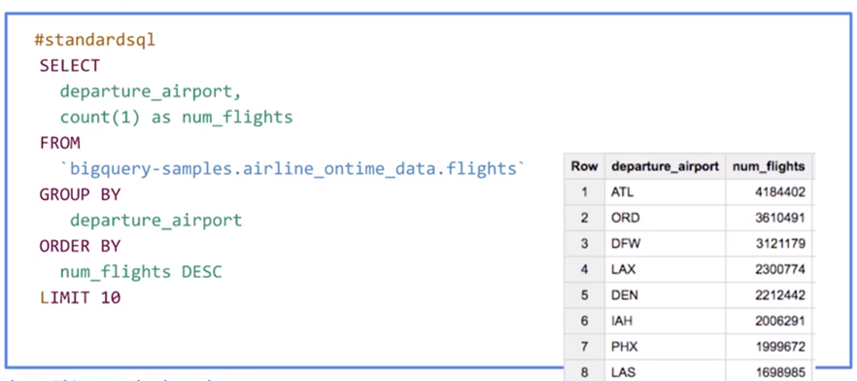
BigQuery, query large data set in seconds
Server less / Autoscale way for Data Analysis
No cluster is needed No index is needed No normalization is needed Data in BigQuery will be denormalized form

Slide 6
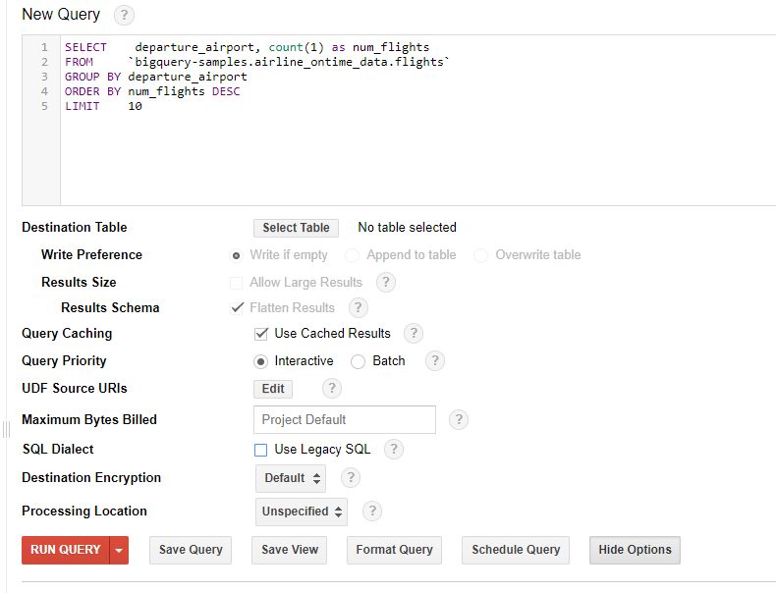
BigQuery, query large data set in seconds
Server less / Autoscale way for Data Analysis
CHECK caching for cached results UNCHECK Legacy SQL since the old version of BigQuery is utilized

Slide 7
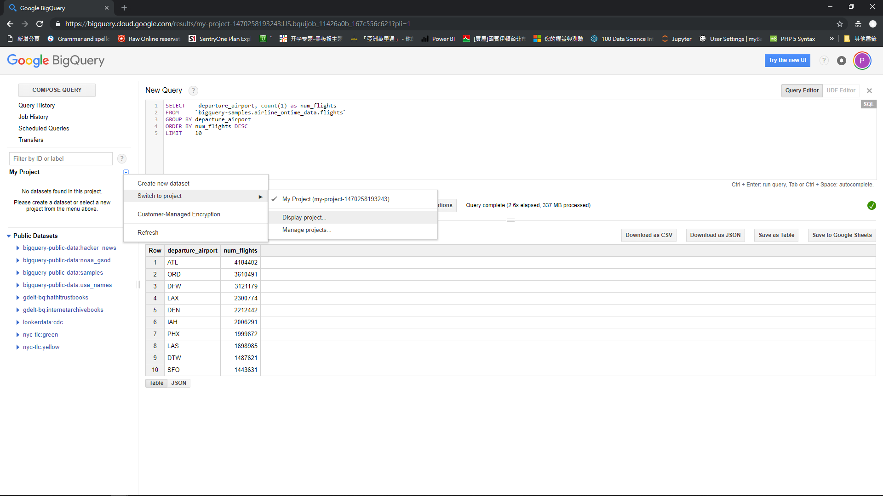
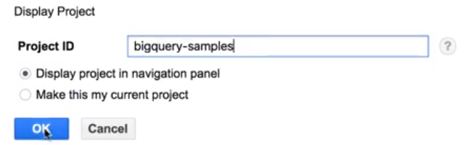
BigQuery, query large data set in seconds
Server less / Autoscale way for Data Analysis
CHECK caching for cached results UNCHECK Legacy SQL since the old version of BigQuery is utilized

Slide 8
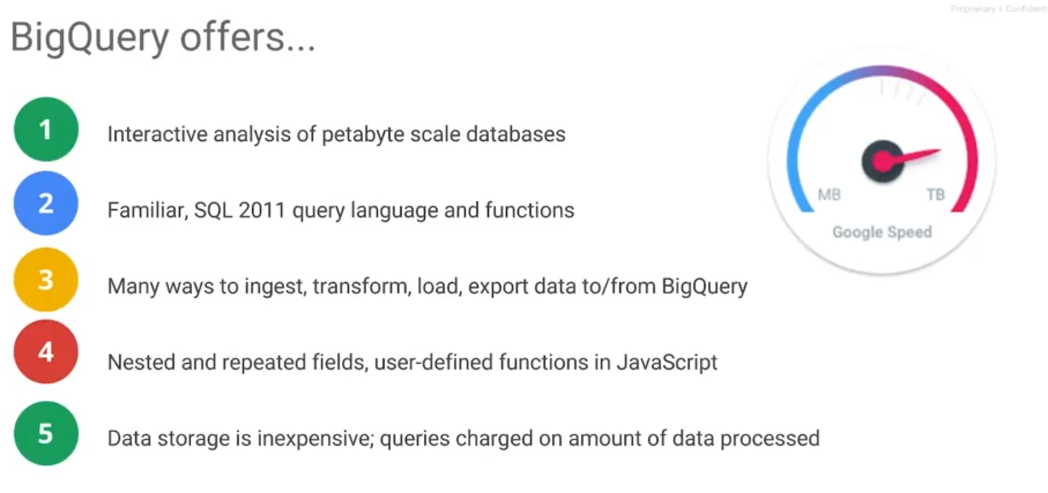
BigQuery, query large data set in seconds
Server less / auto scale way for Data Analysis
no pre-preparation is needed
Standard SQL
Lots of partners are connected with BigQuery

Slide 9
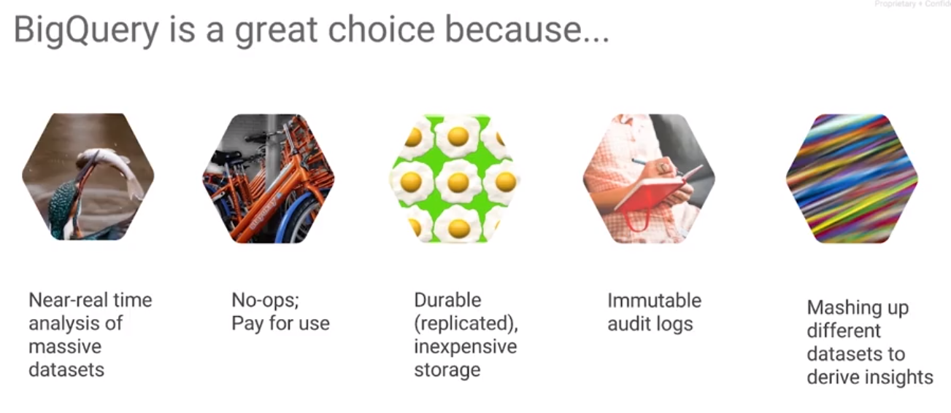
BigQuery, query large data set in seconds
Server less / Autoscale way for Data Analysis
Instantly response? Cloud SQL or Spanner

Slide 10
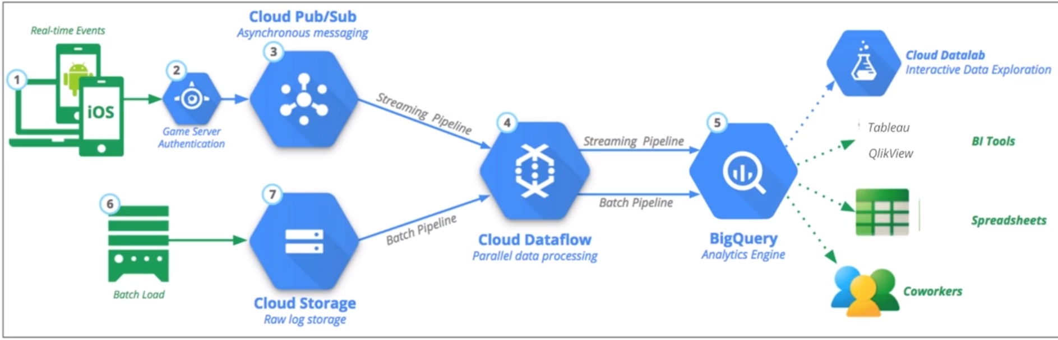
BigQuery, query large data set in seconds
Server less / Autoscale way for Data Analysis
Asynchronous messaging processing
Both batch and real time streaming
Auto scaling parallel data pipeline

Slide 11
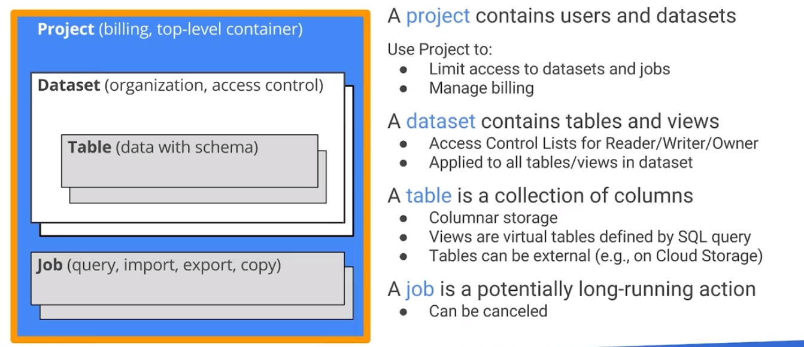
BigQuery, query large data set in seconds
Server less / Autoscale way for Data Analysis

Slide 12
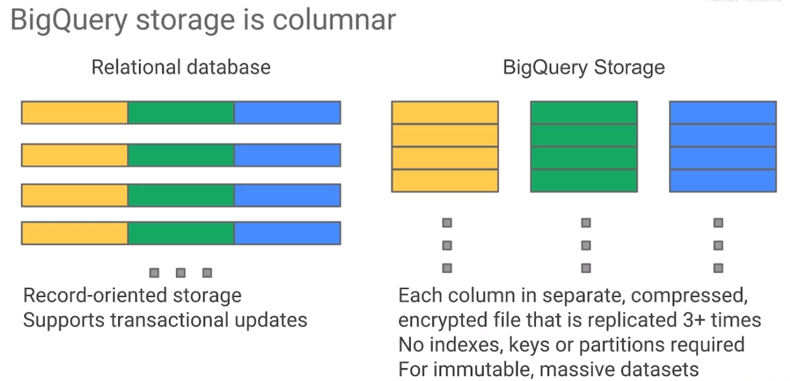
BigQuery, query large data set in seconds
Server less / Autoscale way for Data Analysis
Column by Column, cost-effective no index, cluster, replicate is needed

Slide 13
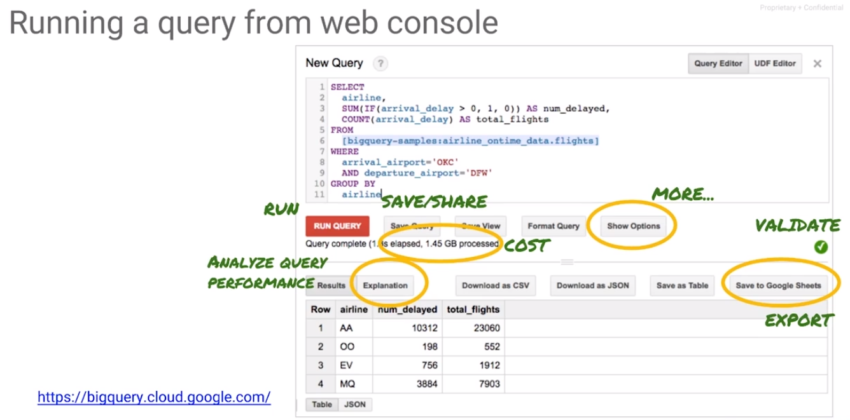
BigQuery, query large data set in seconds
Server less / Autoscale way for Data Analysis

Slide 14
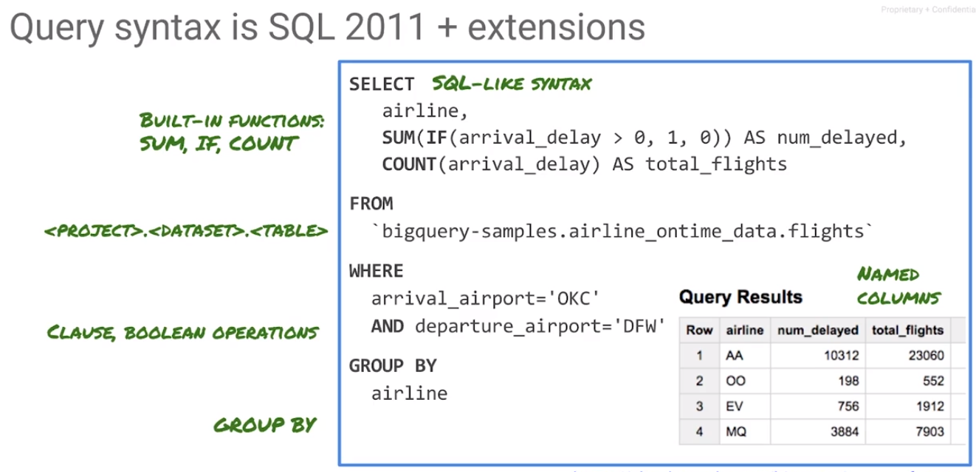
BigQuery, query large data set in seconds
Server less / Autoscale way for Data Analysis

Slide 15
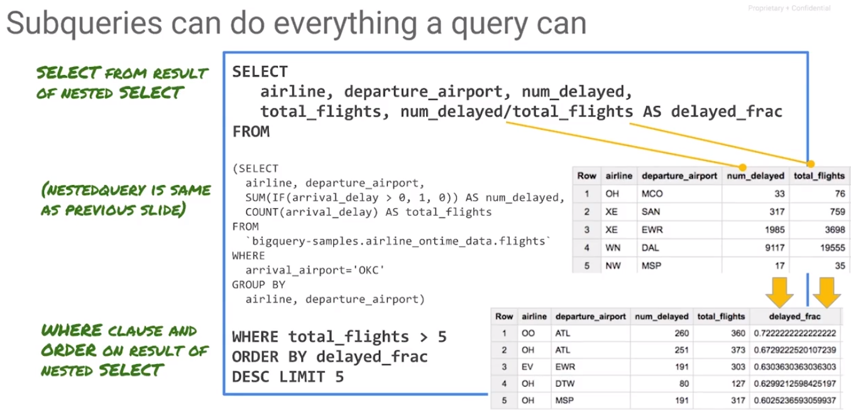
BigQuery, query large data set in seconds
Server less / Autoscale way for Data Analysis
Column by Column, cost-effective no index, cluster, replicate is needed

Slide 16
BigQuery, query large data set in seconds
Server less / Autoscale way for Data Analysis
CHECK caching for cached results UNCHECK Legacy SQL since the old version of BigQuery is utilized

Slide 17
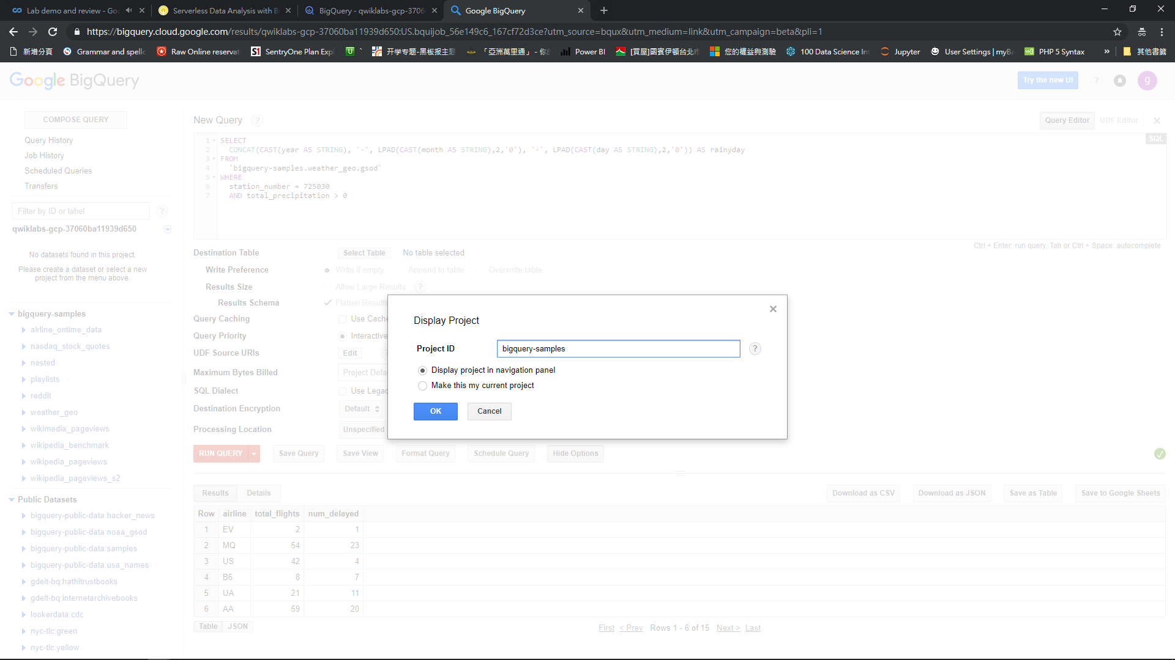

Slide 18
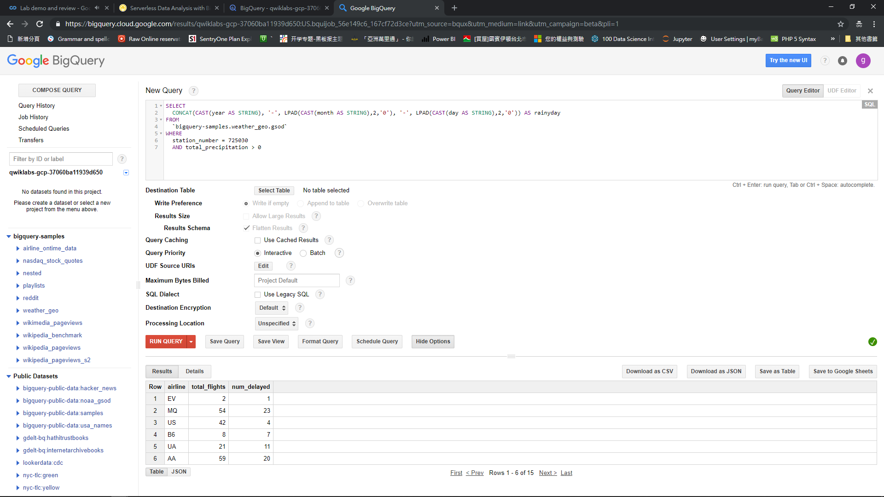

Slide 19
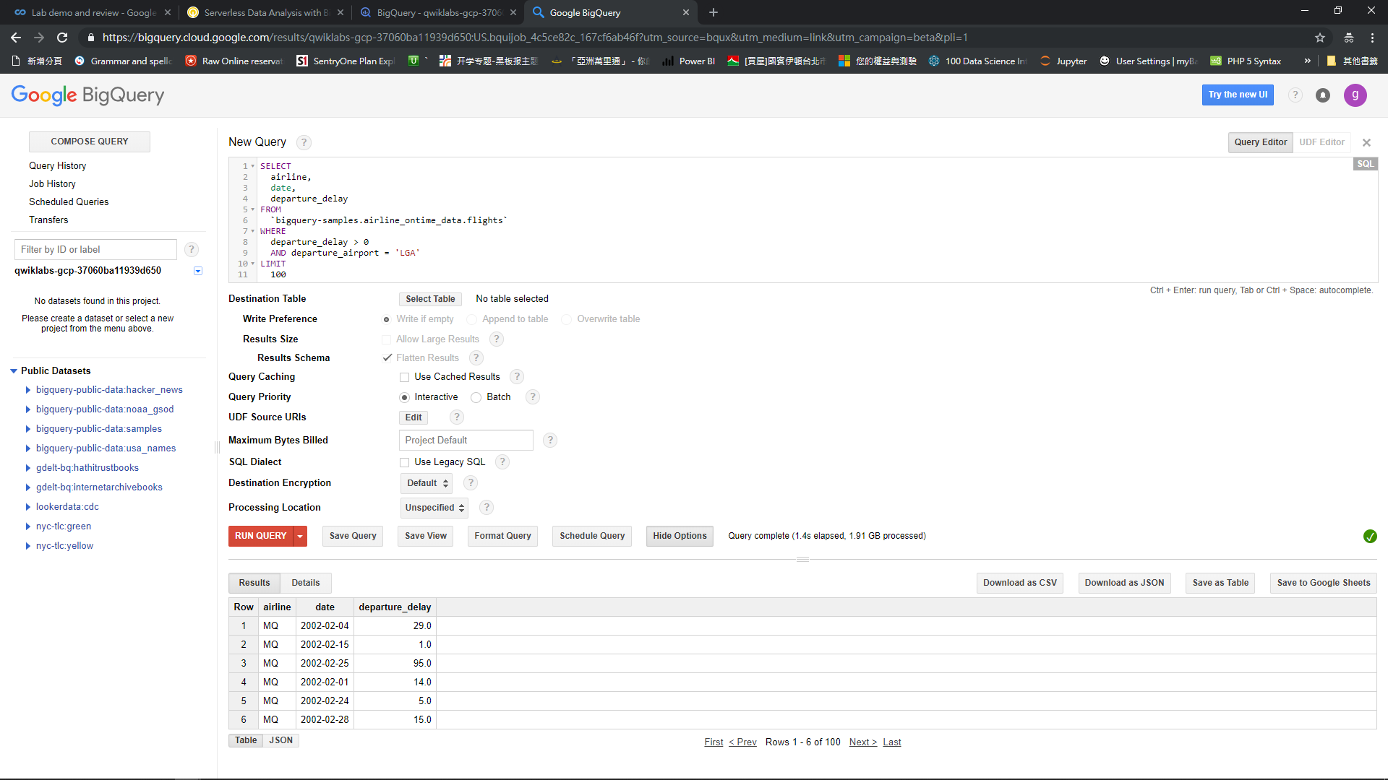
BigQuery, query large data set in seconds
Server less / Autoscale way for Data Analysis
CHECK caching for cached results UNCHECK Legacy SQL since the old version of BigQuery is utilized

Slide 20
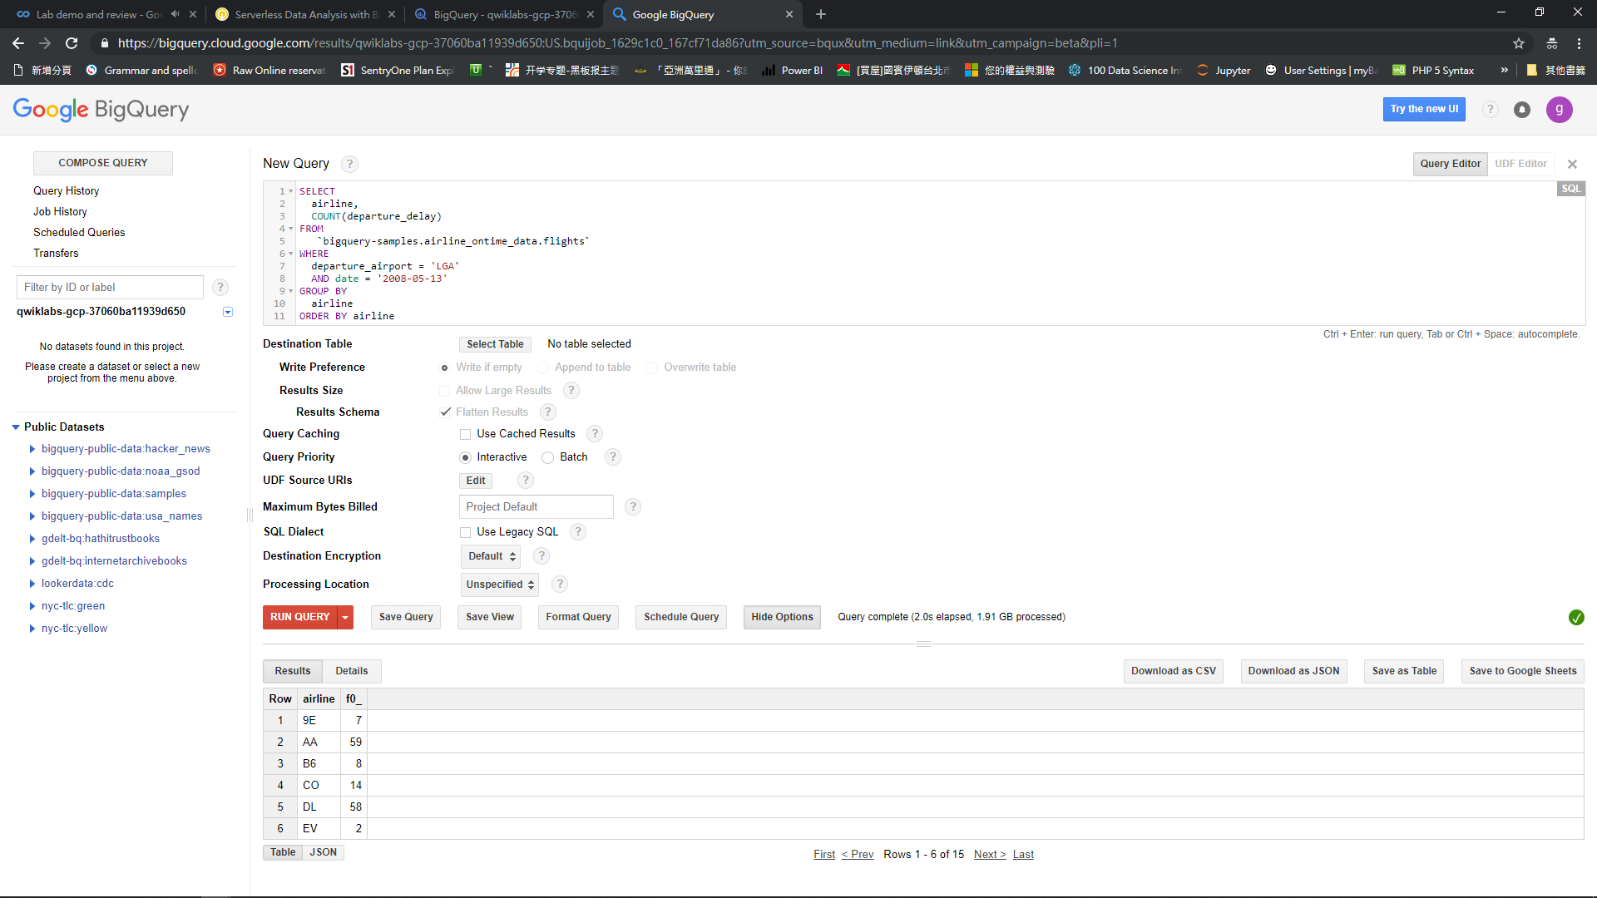

Slide 21
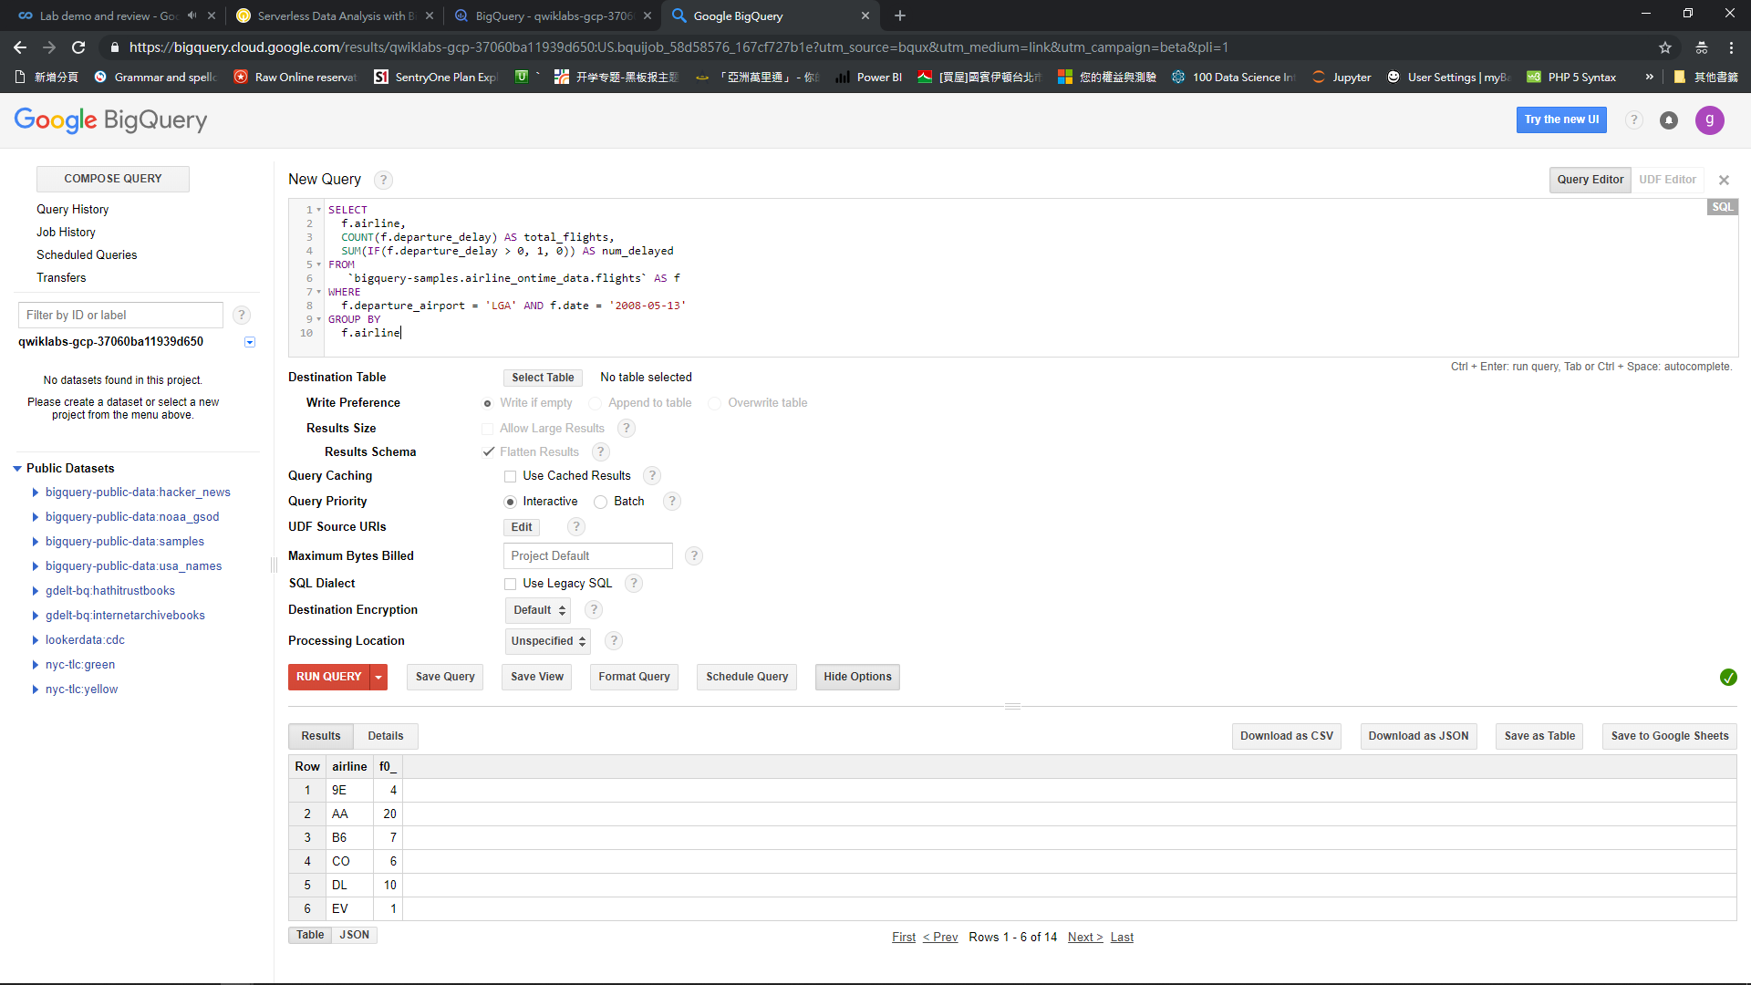

Slide 22
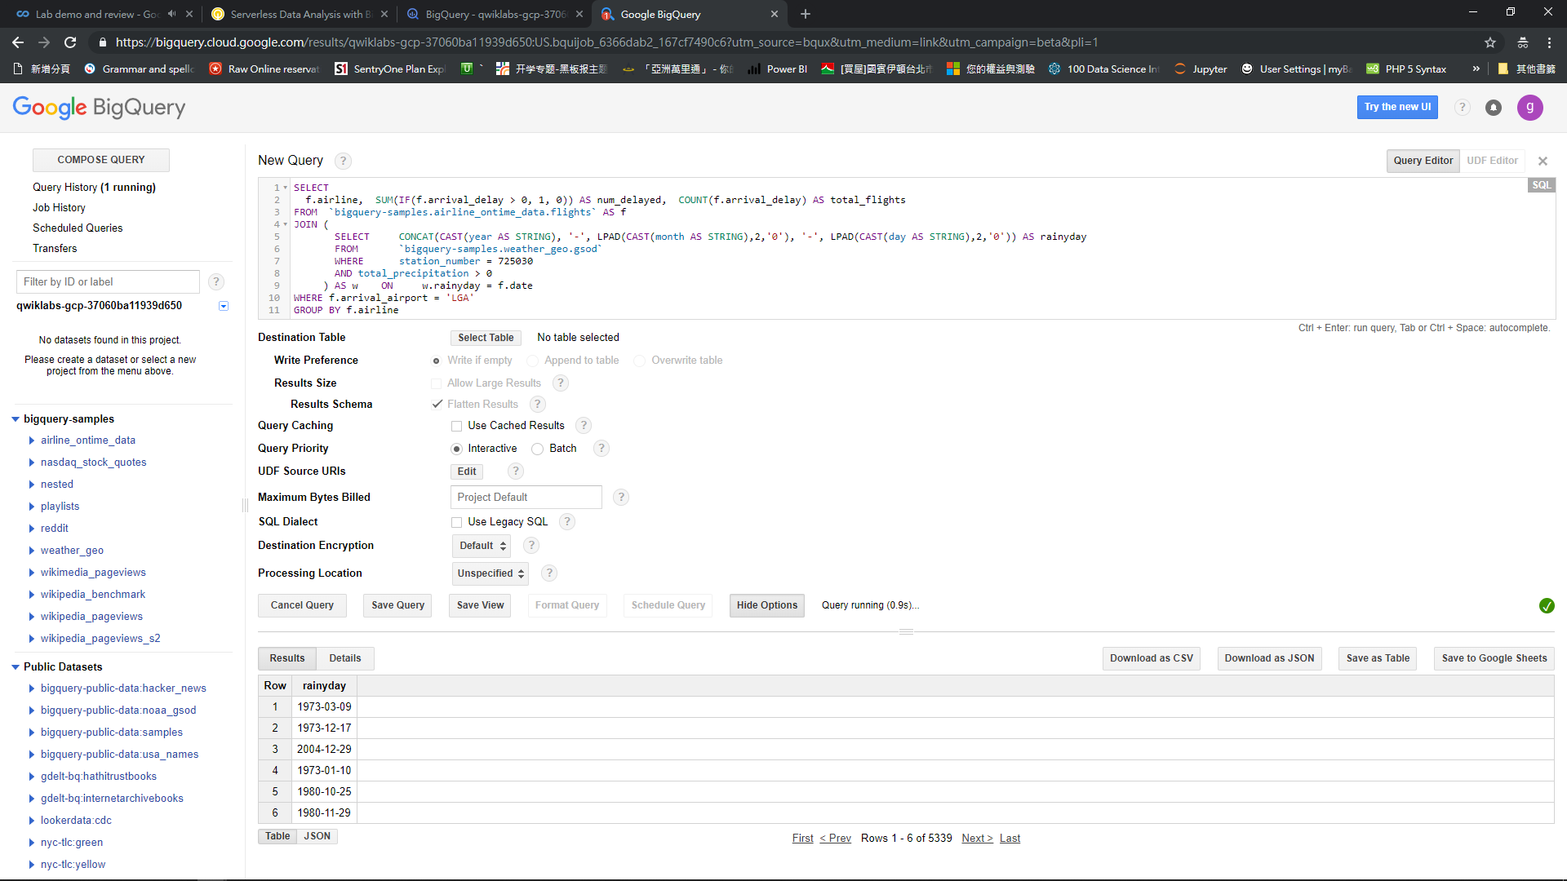

Slide 23
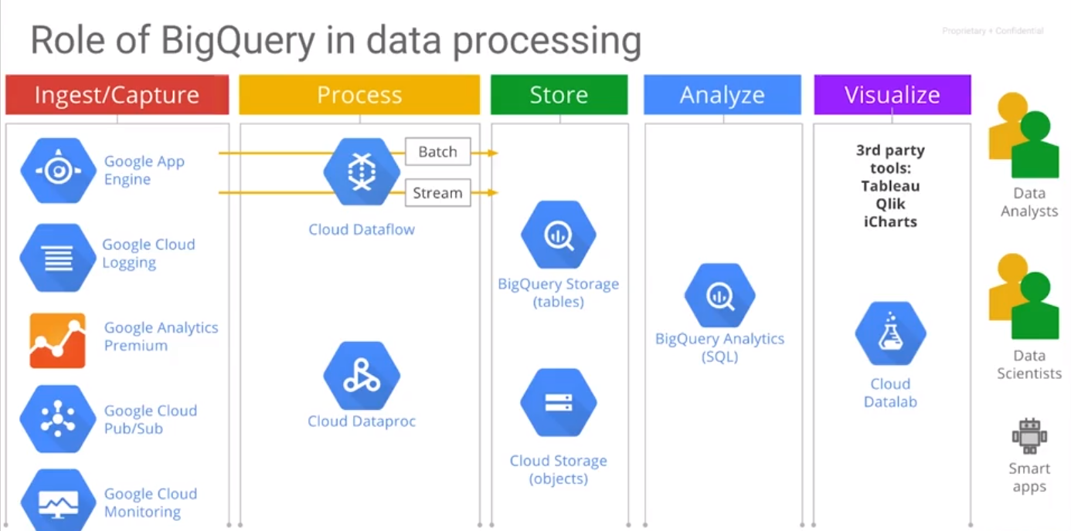
BigQuery, data loading
Server less / Autoscale way for Data Analysis
CHECK caching for cached results UNCHECK Legacy SQL since the old version of BigQuery is utilized

Slide 24
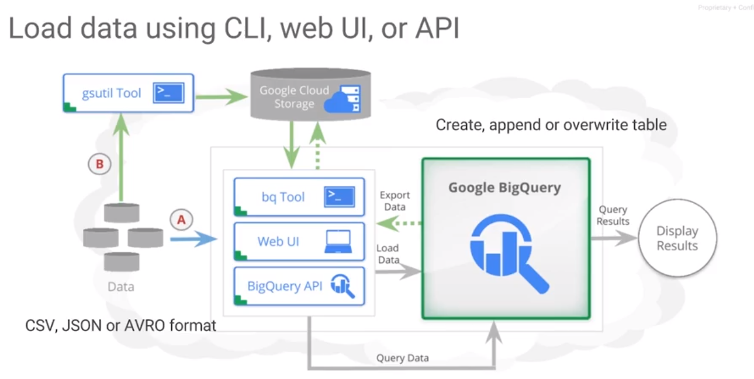
BigQuery, data loading
Server less / Autoscale way for Data Analysis
CHECK caching for cached results UNCHECK Legacy SQL since the old version of BigQuery is utilized

Slide 25
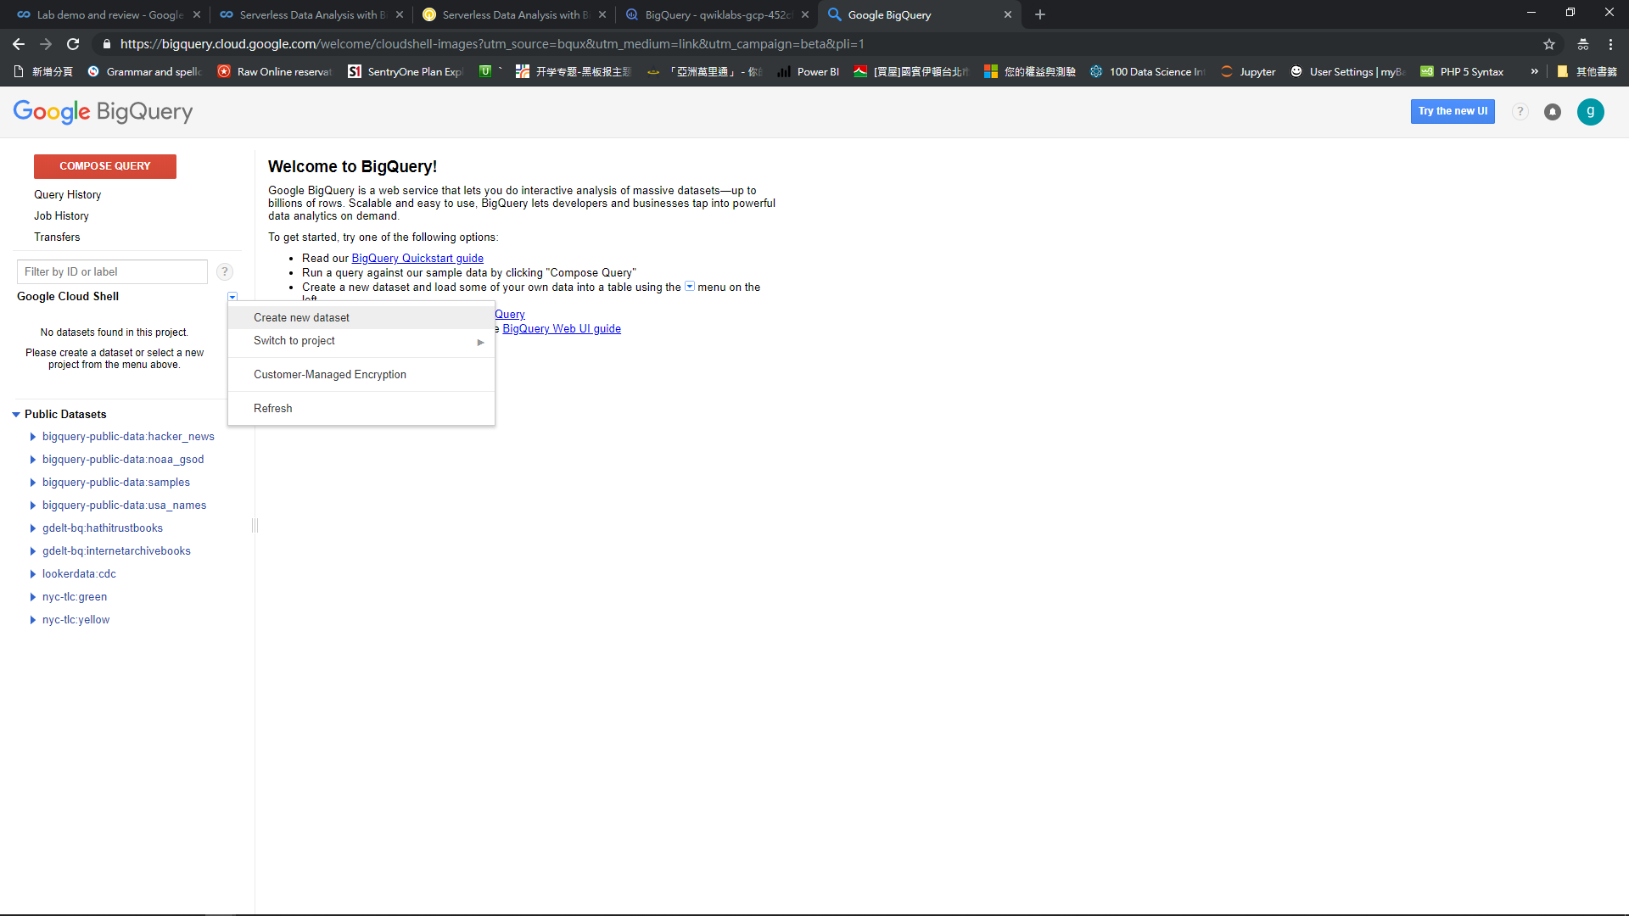
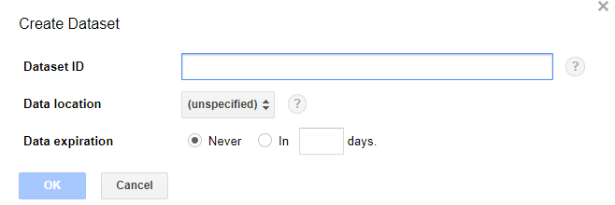
BigQuery, data loading
Server less / Autoscale way for Data Analysis
CHECK caching for cached results UNCHECK Legacy SQL since the old version of BigQuery is utilized

Slide 26
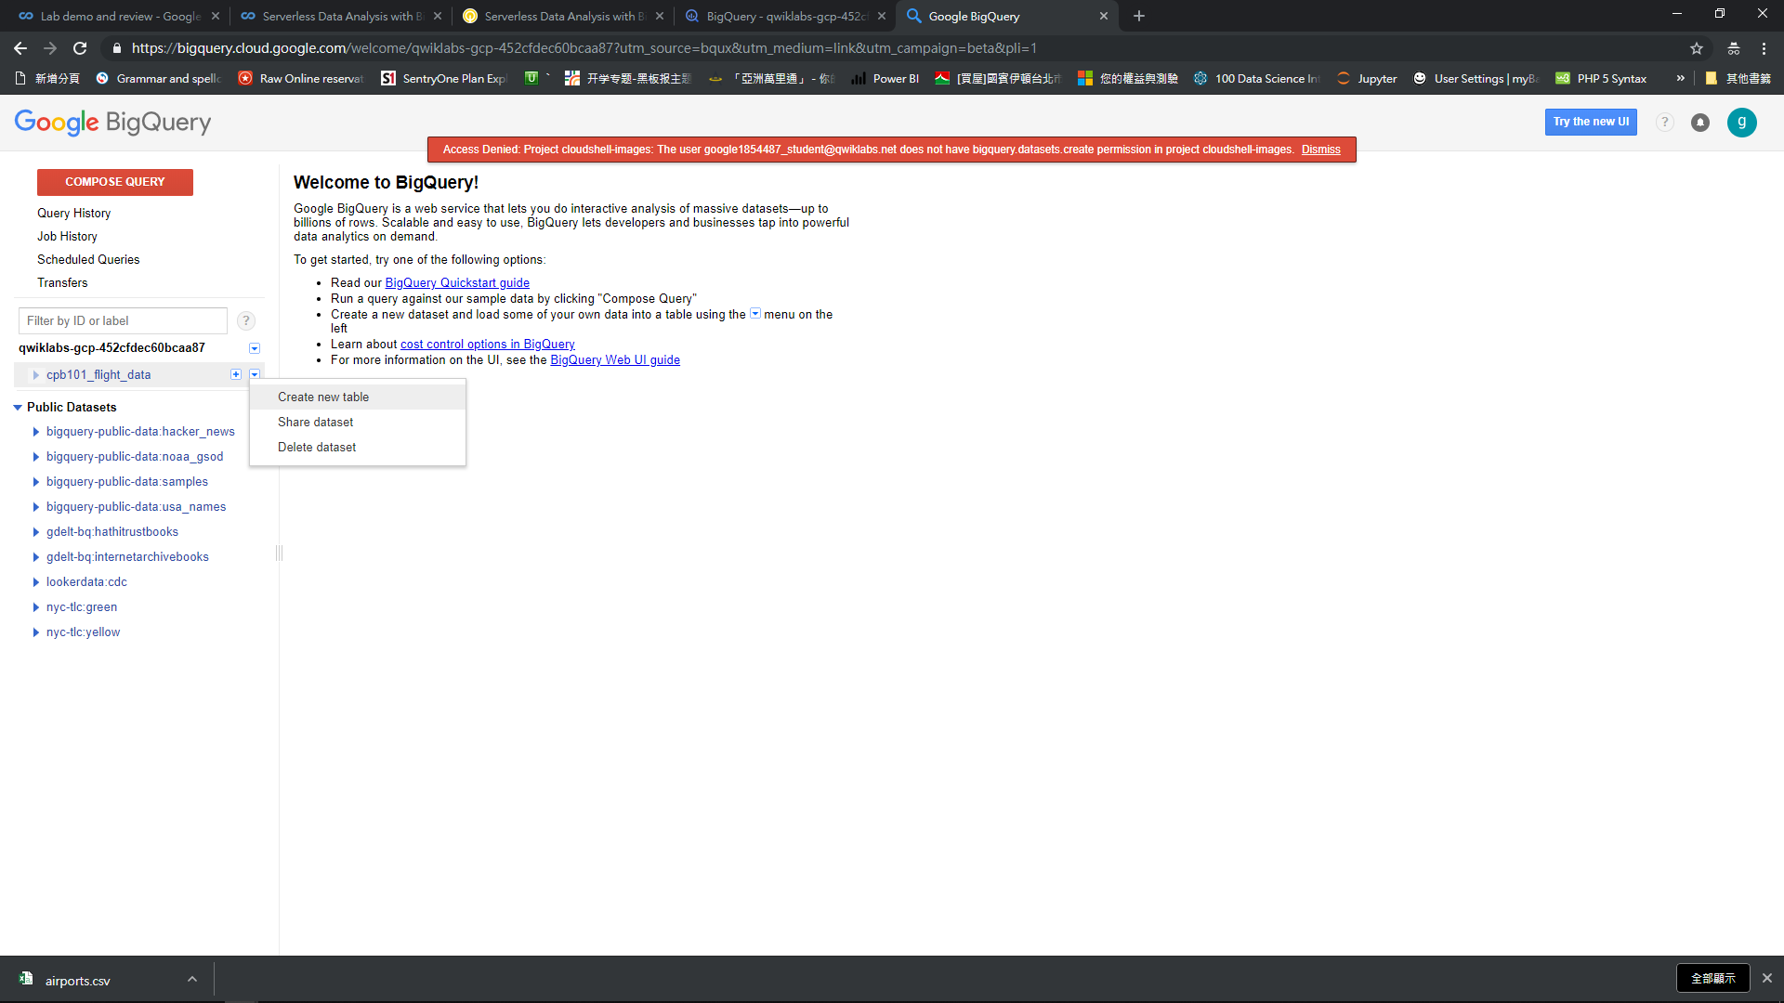
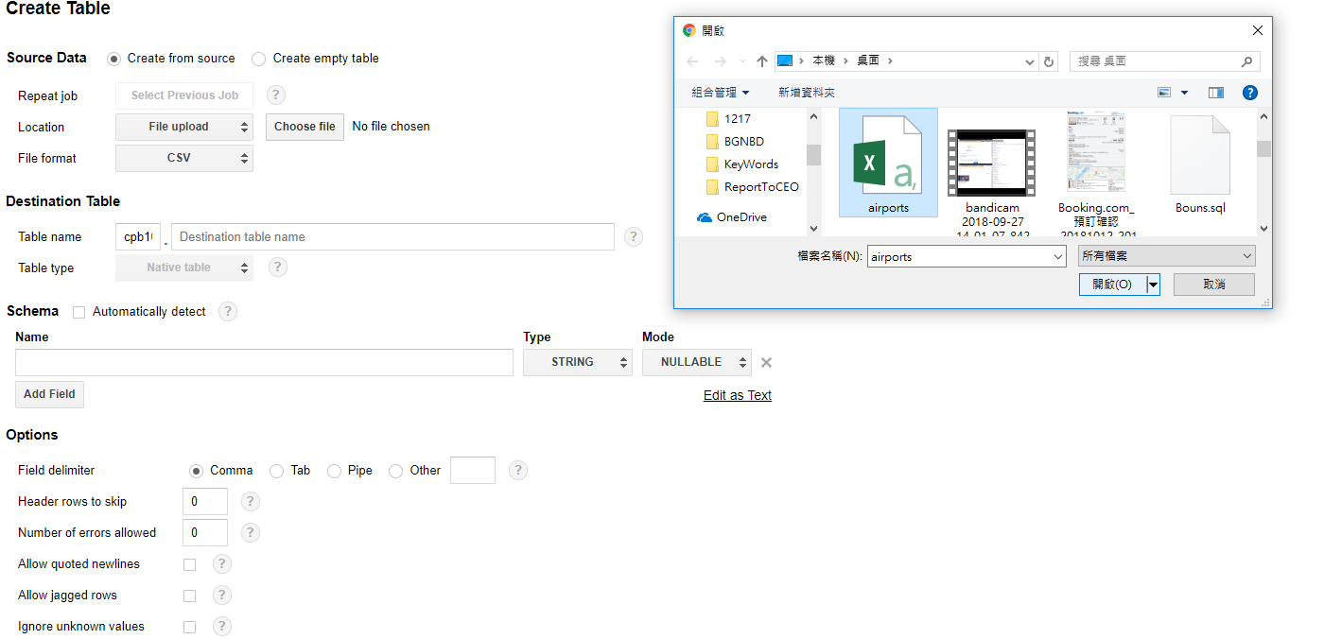

Slide 27
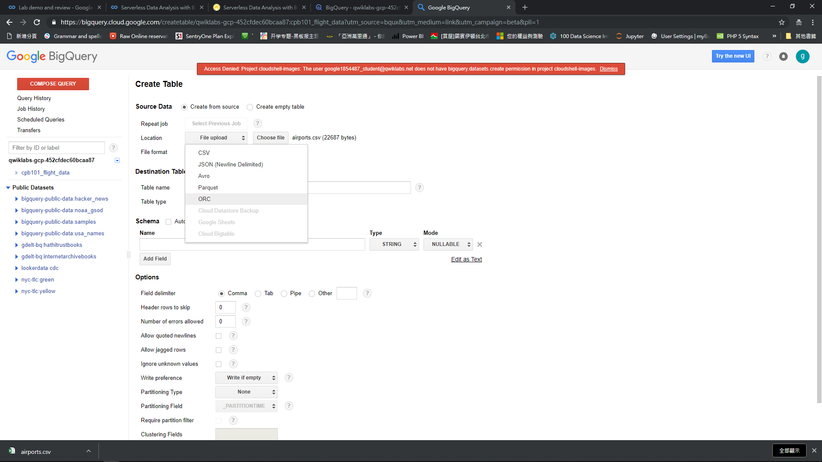

Slide 28
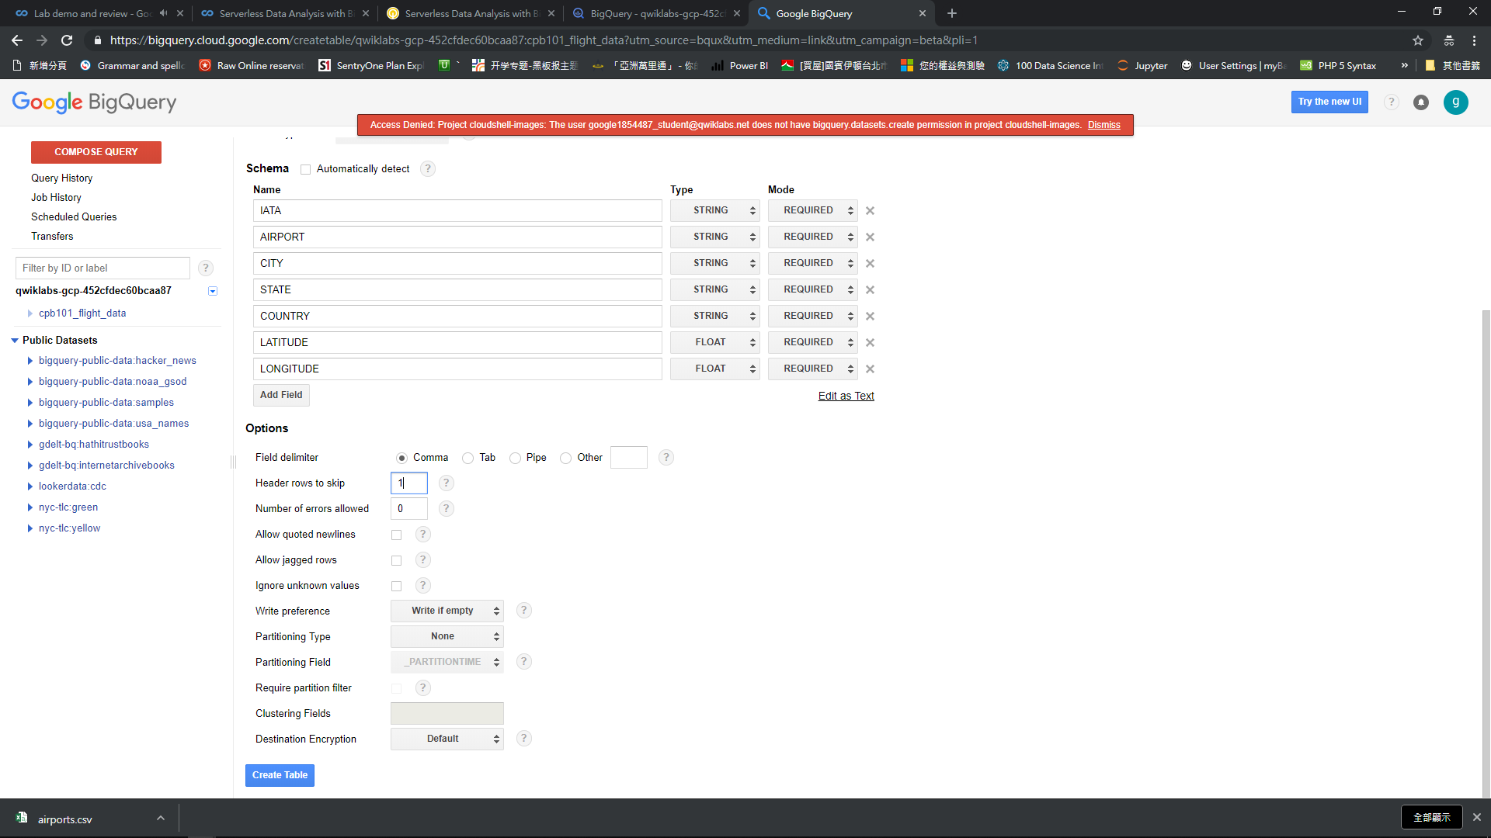

Slide 29
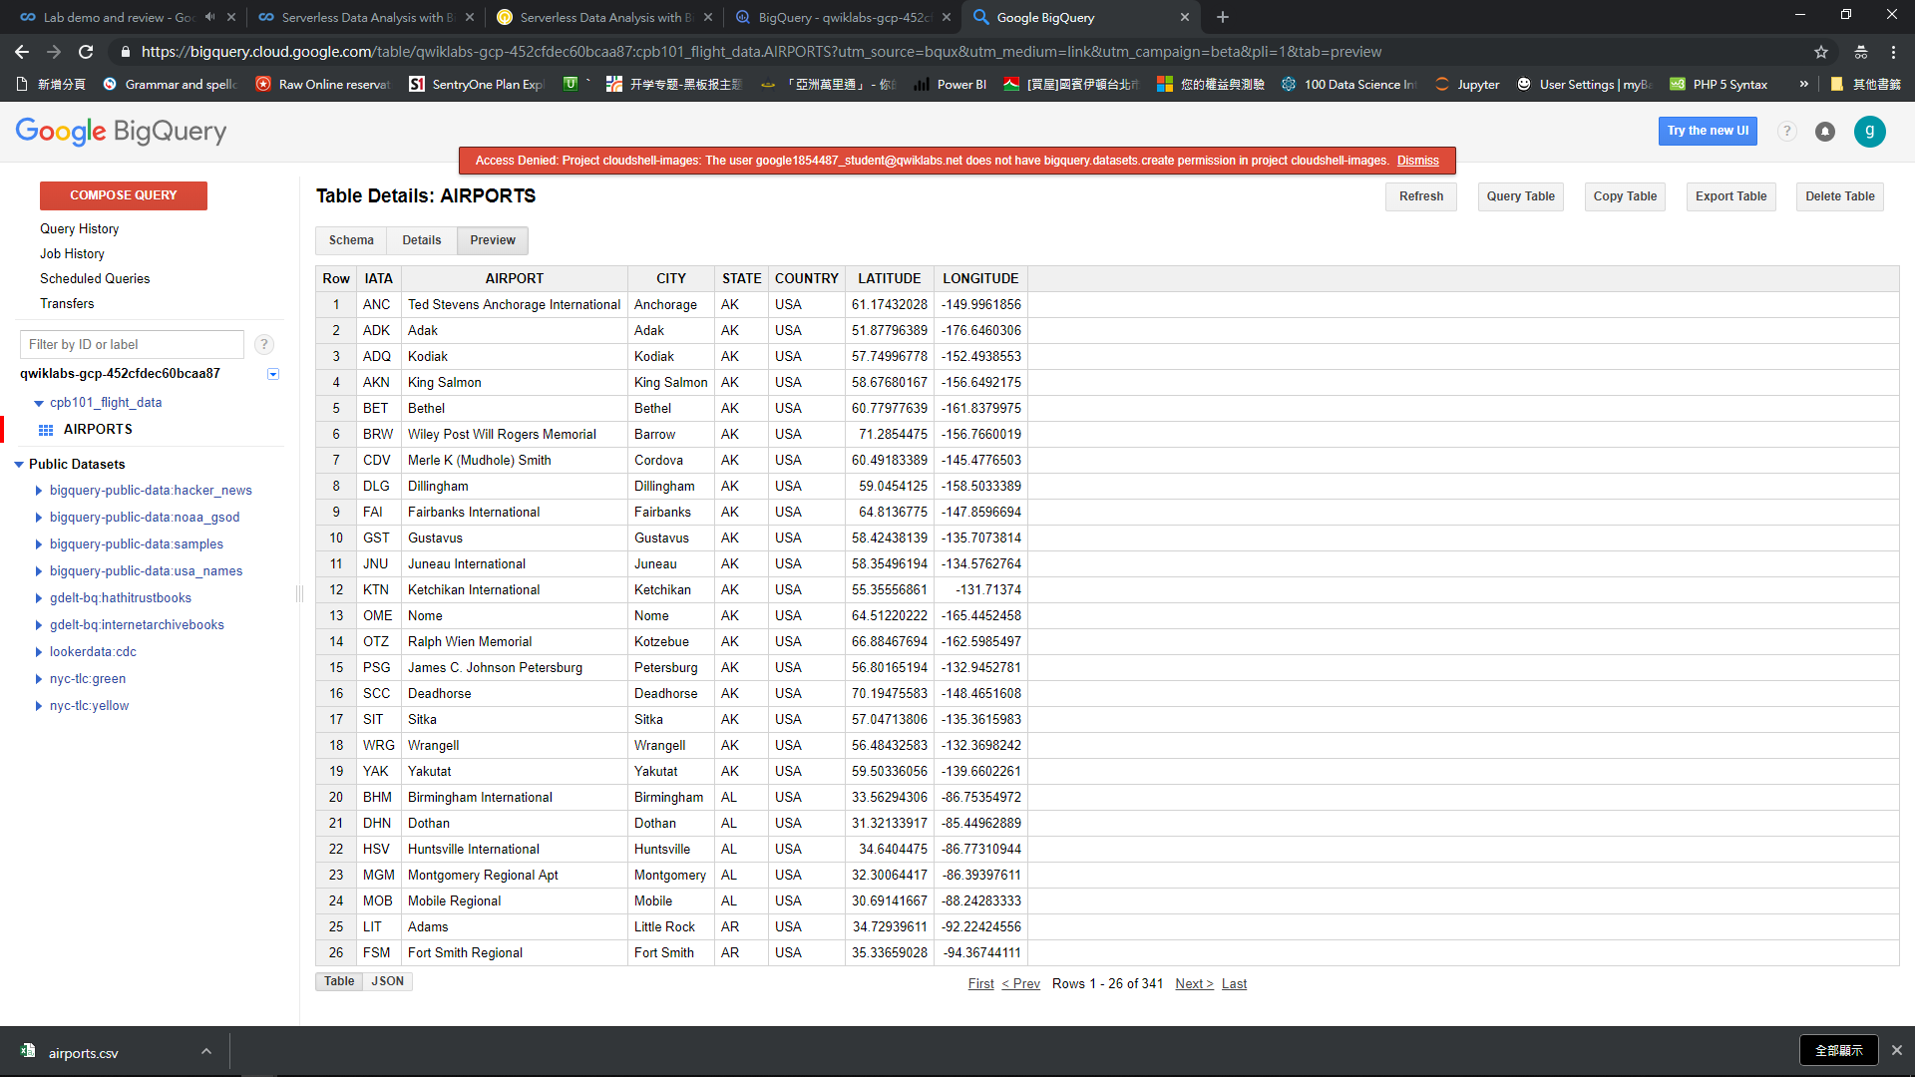

Slide 30
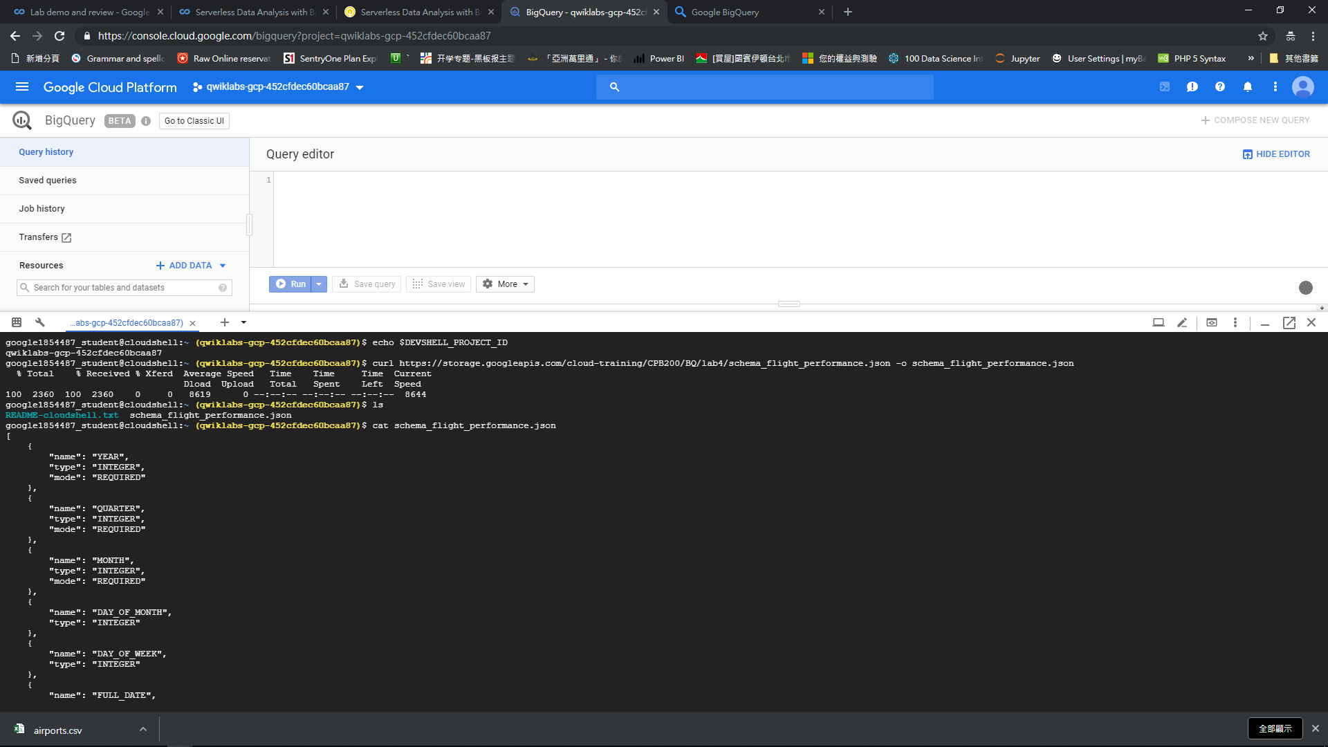

Slide 31
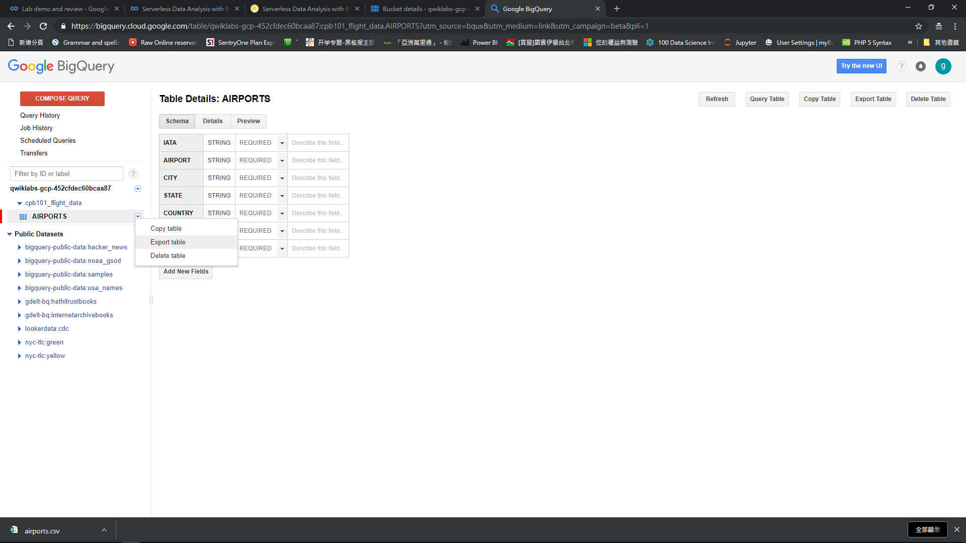
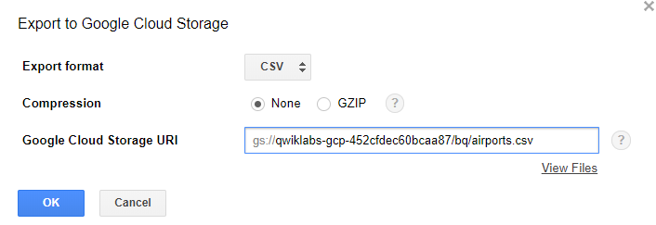

Slide 32
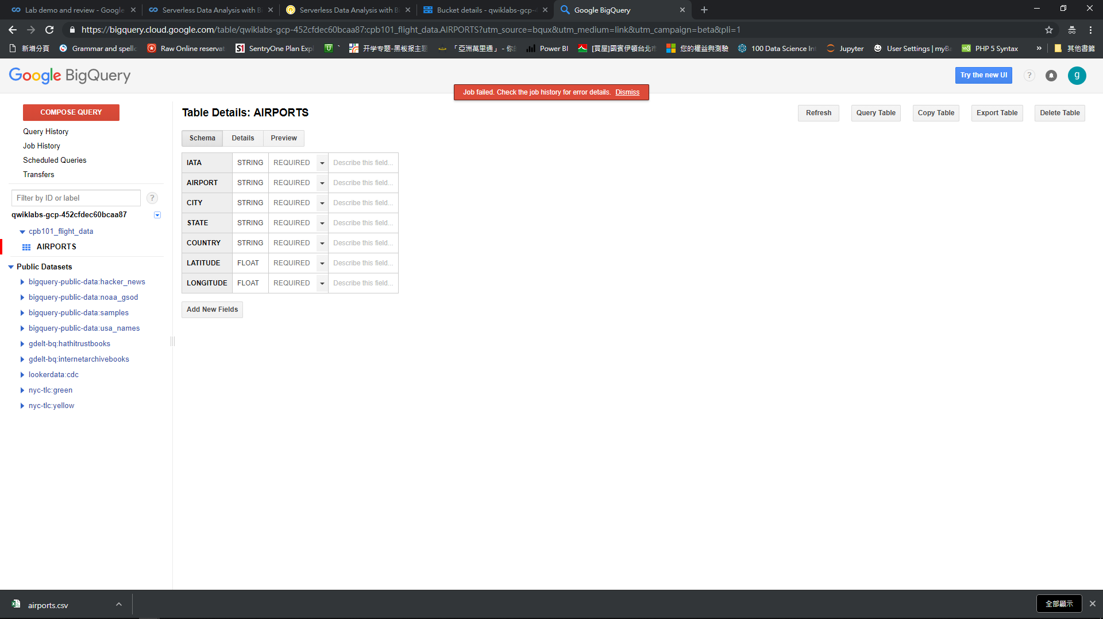

Slide 33
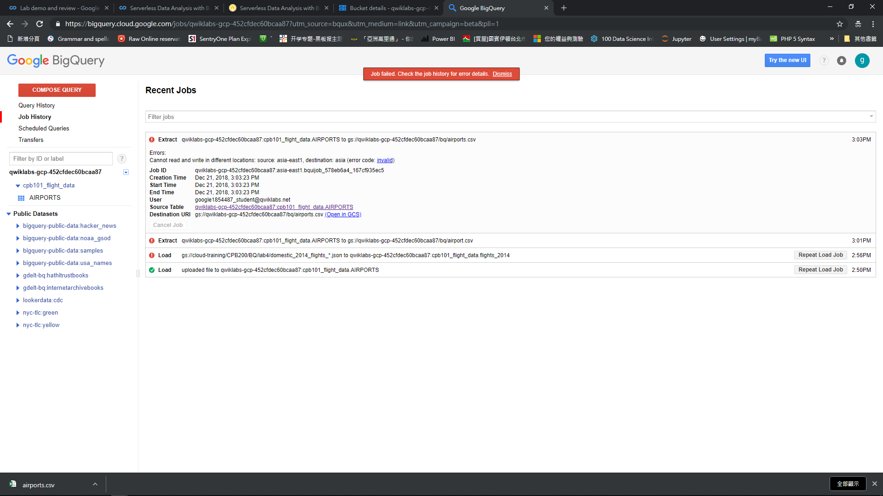

Slide 34
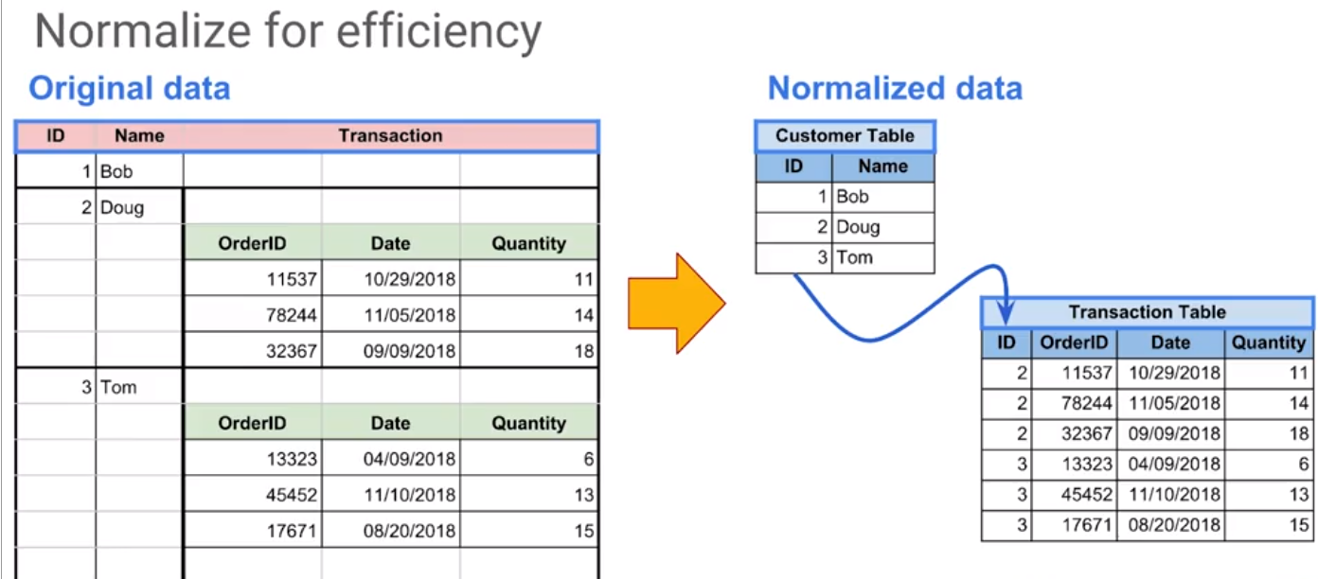
BigQuery, SQL
Server less / Autoscale way for Data Analysis
CHECK caching for cached results UNCHECK Legacy SQL since the old version of BigQuery is utilized

Slide 35
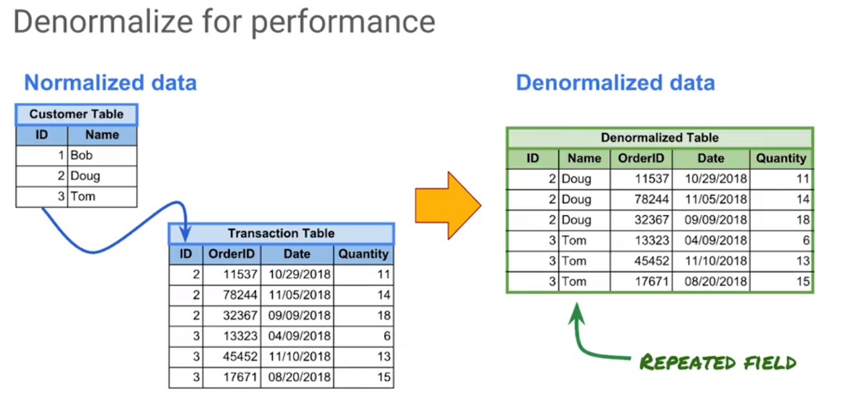
BigQuery, SQL
Server less / Autoscale way for Data Analysis
CHECK caching for cached results UNCHECK Legacy SQL since the old version of BigQuery is utilized

Slide 36
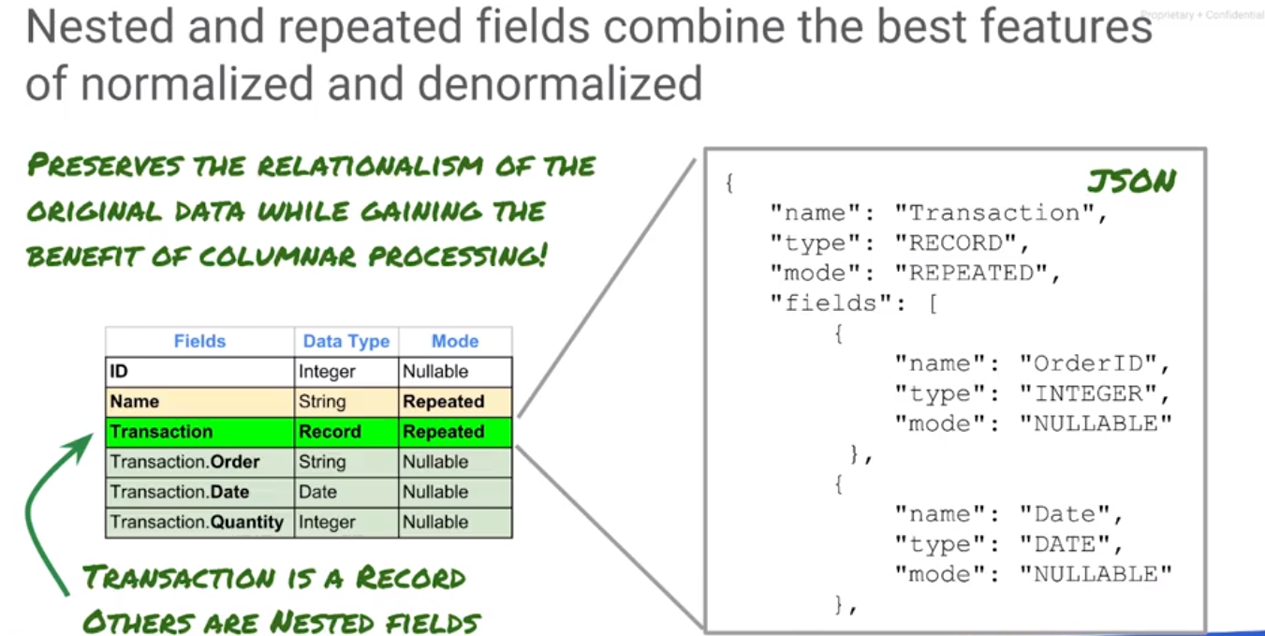
BigQuery, SQL
Server less / Autoscale way for Data Analysis
CHECK caching for cached results UNCHECK Legacy SQL since the old version of BigQuery is utilized

Slide 37
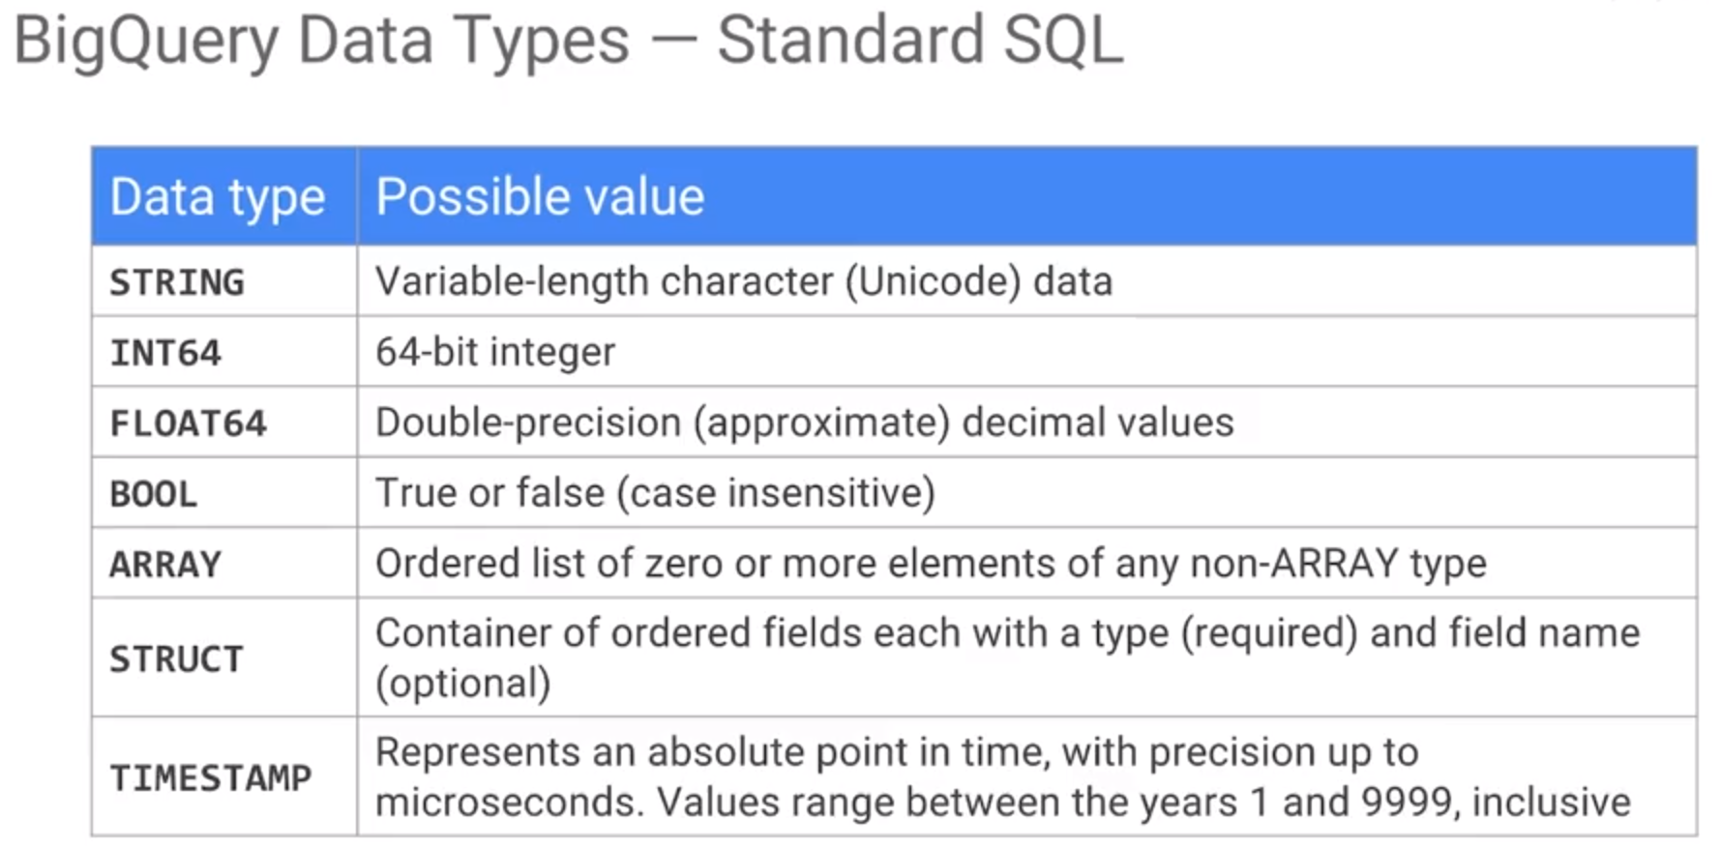
BigQuery, SQL
Server less / Autoscale way for Data Analysis
CHECK caching for cached results UNCHECK Legacy SQL since the old version of BigQuery is utilized

Slide 38
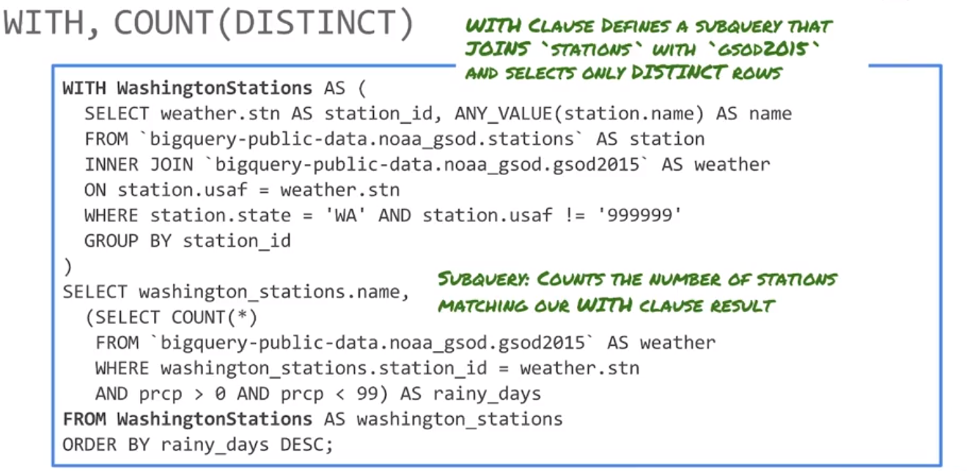
BigQuery, SQL
Server less / Autoscale way for Data Analysis
CHECK caching for cached results UNCHECK Legacy SQL since the old version of BigQuery is utilized

Slide 39
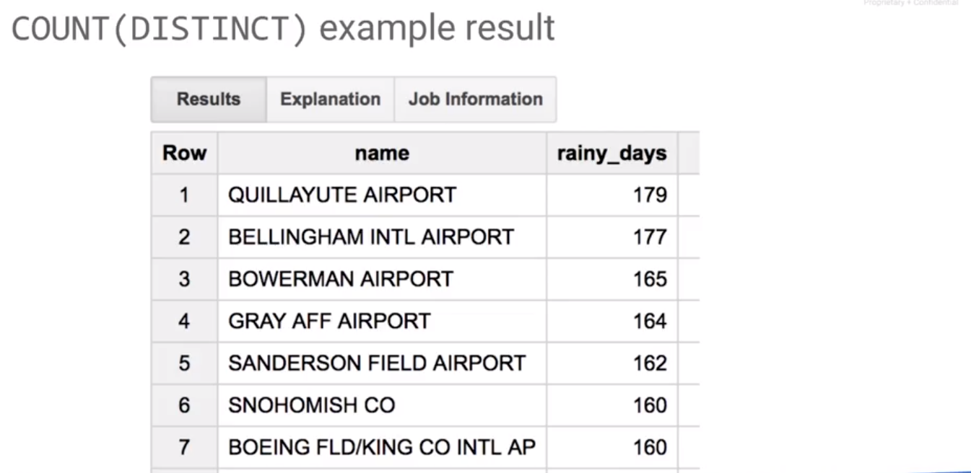
BigQuery, SQL
Server less / Autoscale way for Data Analysis
CHECK caching for cached results UNCHECK Legacy SQL since the old version of BigQuery is utilized

Slide 40
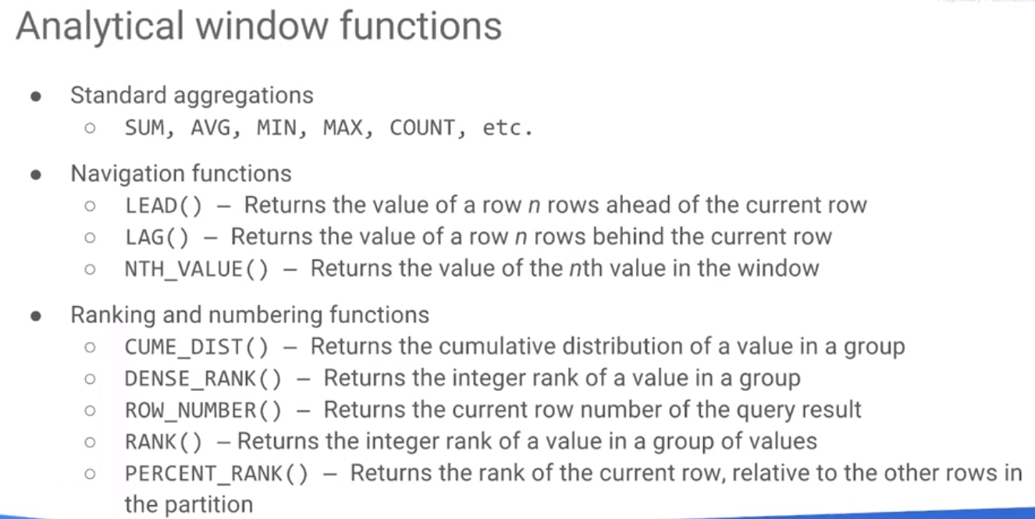
BigQuery, SQL
Server less / Autoscale way for Data Analysis
CHECK caching for cached results UNCHECK Legacy SQL since the old version of BigQuery is utilized

Slide 41
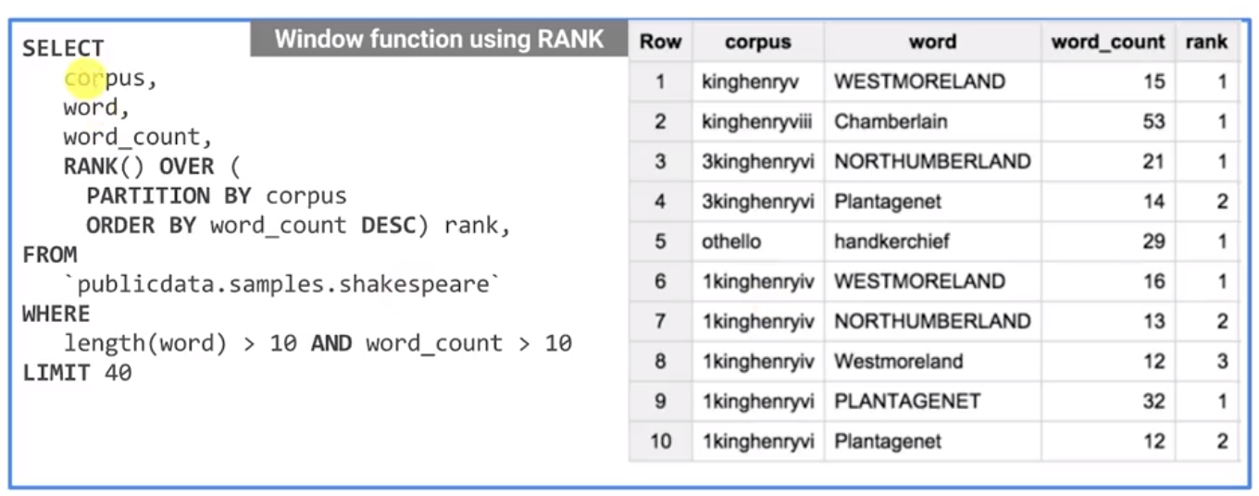
BigQuery, SQL
Server less / Autoscale way for Data Analysis
CHECK caching for cached results UNCHECK Legacy SQL since the old version of BigQuery is utilized

Slide 42
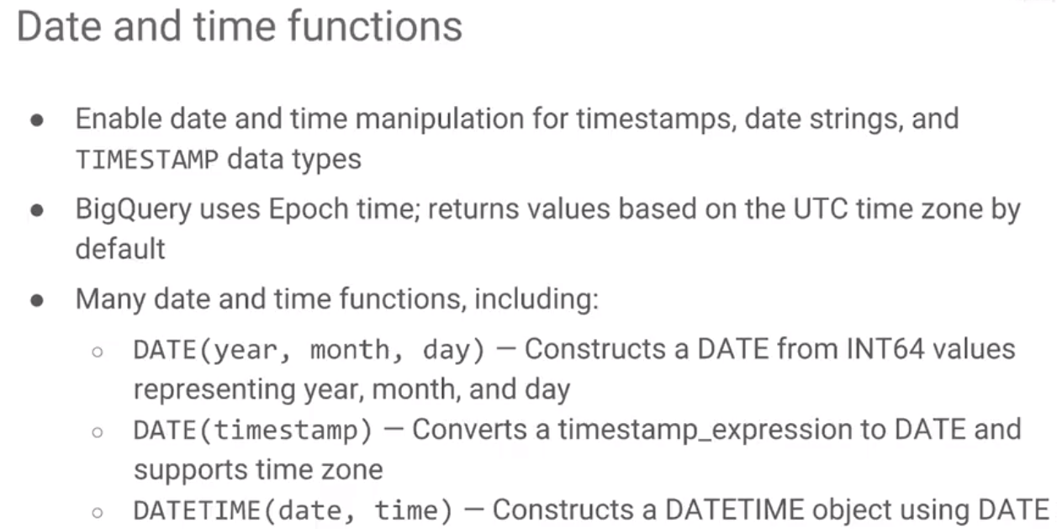
BigQuery, SQL
Server less / Autoscale way for Data Analysis
CHECK caching for cached results UNCHECK Legacy SQL since the old version of BigQuery is utilized

